Slide 1

Ethical Management Self-Revolution of the Toyota-Daihatsu Cooperation
Presented by Group 24

Slide 2

Index
Executive Summary
Current States
Proposed Initiatives
Actions and Criteria
Project Charter
The scandal of Toyota-Daihatsu
Facts, Standards, Actions & Evaluation

Slide 3

Executive Summary
Current State
Proposed Initiatives
Plan of action and criteria for success
Conclusion

Slide 4

Summary of Current State & Proposed Initiative
Current States: Daihatsu is a key Toyota subsidiary that plays an important role in Toyota’s car manufacturing and market expansion. However, it was revealed that the company manipulated the safety tests for its cars of different models.
Proposed Initiatives: Our initiative addresses Daihatsu’s ethical failures by integrating ethics theories, adopting ISO standards (e.g., whistleblowing, AI compliance), and corrective actions in product recall, transparent audits, and a whistleblowing platform. A short-term plan of actions and a long-term plan of standardization aim to restore trust, ensure accountability, and achieve full regulatory compliance.

Slide 5

Summary of Actions and Criteria & Conclusion
Actions and Criteria: We emphasize immediate corrective actions and an ethical after-sales workflow. The whistleblowing system will be enhanced. We also prioritize transparent auditing. Ethical AI systems will be integrated. A cultural transformation will be conducted. To ensure successful improvement, we set and quantify criteria for different actions. Details will be introduced later.
Conclusion: Our proposal for Daihatsu aims to restore brand credibility and ethical integrity through an innovative management system, regulatory frameworks, and technology like AI and blockchain. By emphasizing corrective actions, transparency, and cultural transformation, Daihatsu can enhance accountability, address challenges, and position itself as a leader in ethical automotive practices.

Slide 6

1. Current States
The Toyota-Daihatsu Motor Cooperation
The scandal of Daihatsu
The causes of the scandal
The impacts of the scandal

Slide 7
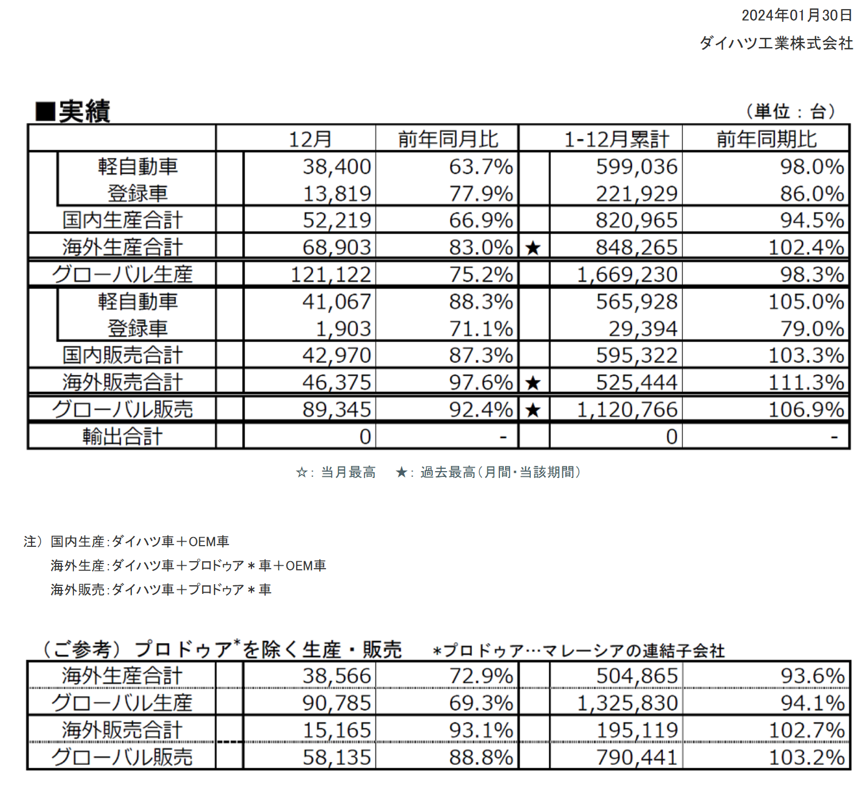
Current States
Toyota-Daihatsu Motor Cooperation
Daihatsu produced more than 1.3 million vehicles in 2023
A major player in the global market, especially in South-East Asia, where Daihatsu accounted for nearly 40 per cent of the Toyota Group's sales in the East Asia Rim.

Slide 8

Current States
The revealing of the scandal
April 2023: revealed flawed side-collision tests for 4 overseas models; launched independent probe.
May 2023: suspended production of Toyota Raize and Daihatsu Rocky after safety issues.
Dec 20, 2023: president reported probe findings to Japan's transport ministry; announced global shipment halt and production pause.

Slide 9
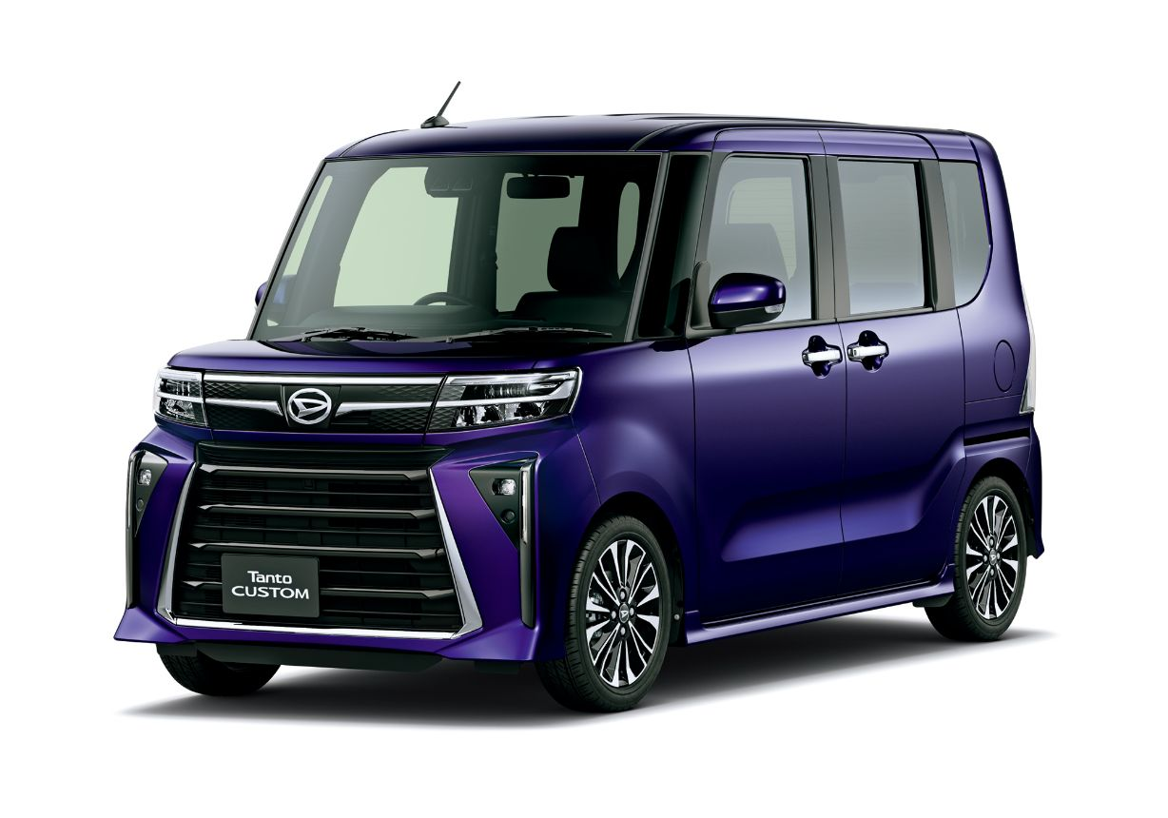
Current States
What causes the scandal
Daihatsu prioritized cost reduction to maintain its dominant position in the market.
They shortcut in safety testing and emissions compliance.
The decentralized management of Toyota's head office allowed Daihatsu to operate with minimal supervision.

Slide 10


Current States
The impacts of the scandal
Serious deterioration of the environment, turning into a disadvantage in the competition
The sales of star products suffered a setback, and the market share was drastically reduced.
Group credibility crisis, Toyota's overall credibility was questioned

Slide 11
2. Proposed Initiatives
Problems identified
Ethical Frameworks
Standardized ethical foundation for actions
Competitive Edges
Schedule and milestones

Slide 12

Proposed Initiatives
Problems identified
HOW TO: ethical emergency handling of the scandal
LACK OF intra-organizational ethical management
LACK OF external accountability of ethical issues
INNOVATIONS in ethical organizational governance standards
We will have a 6-month plan of actions to handle them and a long-term schedule for standards
Daihatsu has flawed side-collision tests.
How about the emerging AI and information systems on automotive products?

Slide 13
Proposed Initiatives
Ethical Frameworks
We should refer to the ethical frameworks – the foundational theories
Virtue Ethics
Set appropriate subjective work ethics for each individual
Deontological Ethics
Seek ethical goals and constraints from objective standards and regular evaluation
We need to enhance and expand our code of conduct for everyone in the cooperation

Slide 14
Proposed Initiatives
Standardized foundation for actions
Ethics in the ongoing recall procedures
ISO 9001:2015 After-sales Service, Corrective Actions, and Customer Compliant, Suggestion and Survey
Intra-organizational Reporting
ISO 37002:2021 Whistleblowing Management System.
External Accountability
ISO 37001:2025 Anti-bribery Management Systems
ISO 19011:2018 Guidelines for Auditing Management Systems

Slide 15
Proposed Initiatives
Standardized foundation for actions
Organizational governance specialized for automotive industry
International Automotive Task Force: IATF 16949:2016
ISO 37000:2021 Governance of Organizations
ISO 9001:2015 Quality Management Systems
International Automotive Task Force: IATF 16949:2016
SO42001:2023 Artificial Intelligence Management Systems
ISO 23894:2023 Guidance on Risk Management of AI Systems
ISO27001:2022 Information Security
ISO 5338:2023 AI System Life Cycle Processes
AI and information systems on automotive products
Standards can navigate us to efficient actions;
we are also expected to obtain ISO certifications.

Slide 16

Proposed Initiatives
Schedule
Need timeline to obtain certification from current ISO standards
Short-term (in 6 months)
Medium-term (in 2 years)
Long-term (final goal)
Medium-term (in 1 year)
The plan of actions to the identified problems, detailed in the next section and project charter
Design, conclude, and implement ethical organizational management standards specialized for automotive industry
Design, conclude, and implement ethical AI and information system management specialized for automotive products
Continuous improvement, become a manufacturer with zero ethical defects

Slide 17

Timeline for Standards Certifications
Year 1
Ethical organizational management
ISO 9001:2015
ISO 37002:2021
ISO 37001:2025
ISO 19011:2018
ISO 37000:2021
IATF 16949:2016
Year 2
Ethical AI & information systems management
ISO 42001:2023
ISO 23894:2023
ISO 27001:2022
ISO 5338:2023
IATF 16949:2016

Slide 18
Two Phases for Standards Certifications For Each phase:
Design
Implement
Assessment
Continuous assessment
2 months: invite professional certification bodies under CASCO standards for on-site assessment and certification
6 months: modify existing organizational policies, establish new standardized programs, employee training, and conduct internal compliance auditing
2 months: for every identified problems, conclude the relevant standards and design a checklist for implementation

Slide 19
Proposed Initiatives
Competitive Edges
Reputation
Timely recovery and improvement of brand reputation
Financial cost
Early standardization can reduce the expense of future compliance reviews
The new trend
Catch up with the technological trend
Embrace future opportunities

Slide 20

3. Actions and Criteria

Slide 21
Proposed Initiatives
Schedule
Need timeline to obtain certification from current ISO standards
Short-term (in 6 months)
Medium-term (in 2 years)
Long-term (final goal)
Medium-term (in 1 year)
The plan of actions to the identified problems, detailed in the next section and project charter
Design, conclude, and implement ethical organizational management standards specialized for automotive industry
Design, conclude, and implement ethical AI and information system management specialized for automotive products
Continuous improvement, become a manufacturer with zero ethical defects

Slide 22
Plan of Actions
Provide training on anti-retaliation policies and ethical escalation protocols
Build a transparent whitstleblowing platform accessible to all employees
Immediate Corrective Actions & Ethical After-Sales Workflow
Create after-sale workflow
Automating customer complaint tracking
Whistleblowing & Governance Enhancement
Integrate AI & blockchain into auditing system
Establish an Ethics Oversight Committee with external auditors and employee representatives
Auditing & Public Transparency
Partner with third-party auditors

Slide 23
Plan of Actions
Ethical AI & Information Systems Integration
Ensure ethical AI adoption
Integrating AI lifecycle standards into vehicle software development
Offer special AI ethics training for employees
Cultural Transformation & Virtue Ethics
Draft a "Safety First" code emphasizing accountability, transparency, and customer safety
Reward teams for proactive safety improvements and ethical decision-making

Slide 24


Key Impacts
Technology:
AI/ML will predict safety risks, automate recalls, and detect anomalies in testing
Take over manual roles like testing
People:
Employees may have initial resistance to new workflows
Increasing need of human's ethical oversight and stakeholders' engagement
Upskill opportunities in tech-skills and soft-skills

Slide 25


Key Impacts
Jobs & Management:
Increasing accountability for ethical lapses
Collaboration on decision-making with the Ethics Oversight Committee
Concerns:
whistleblowers may fear retaliation if their identity is leaked
Internal audits may lack objectivity if influenced by external incentives

Slide 26
Evaluation Criteria
Immediate Corrective Actions & Ethical after-Sales Workflow
Whistleblowing & Governance Enhancement
100% of audits conducted by third parties with no conflicts of interest
Auditing & Public Transparency
Reduction in recall resolution time (goal: 50% faster)
90% safty-related complaints are resolved within 24 hours by AI-powered automated system
80% employees aware of the whistleblowing system
All employees complete anti-retaliation and escalation protocol training.
Audit findings published quarterly with <10% unresolved critical issues
Zero retaliation cases against whistleblowers

Slide 27
Evaluation Criteria
Ethical AI & Information Systems Integration
100% compliance with ISO/IEC 42001 within 18 months
Cultural Transformation & Virtue Ethics
80% employee participation in mandatory ethical training
"Safety First" code embedded in 100% of performance reviews and team KPIs
Zero reported incidents of AI bias or safety risks in vehicle software
90% of AI developers complete ethics training and certification

Slide 28
Evaluation Criteria
Standardization of Actions
In the first year, all ISO-recognized certificates regarding updating ethical organizational governance for automotive industry should be obtained
In the second year, all ISO-recognized certificates regarding ethical technological innovations management should be obtained
All adapted standards should be evaluated and recertificated every five years by a third party

Slide 29

Appendix Project Charter

Slide 30
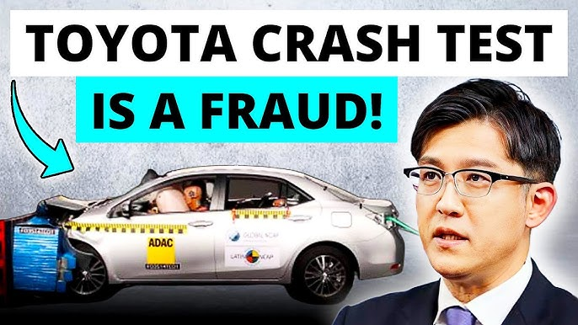

Business Case & Goal
Daihatsu Motors is facing manipulated safety test results that raised significant safety concerns, and an independent investigation has uncovered flaws in emissions and environmental data.
Goal
Enhance improved policies, quality assurance, regulatory compliance
Prevent future similar incidents
Restore customer trust in Daihatsu’s products.

Slide 31
Milestone for Plan of Actions
Mar 19: Project Start (Define Project Charter)
Mar 26: Stakeholder Engagement and Initial Risk Assessment
Apr 10: Create After-Sale Workflow
Apr 24: Automating Customer Complaint Tracking
May 8: Whistleblowing & Governance Enhancement
May 22: Analyze Current Security Testing Data & Analyze Materials for Certification Alignment
Jun 5: Develop To-Be Safety Control and Testing Framework
Jun 19: Stakeholder Review and Feedback on Proposed Framework
Jun 26: Establish Ethics Oversight Committee
Jul 10: Testing of Enhanced Safety Measures & Integrate AI & Blockchain into Auditing System
Jul 24: Training and Preparation for Rollout
Aug 7: Rollout Enhanced Security Controls, Testing Protocols, and Whistleblowing Platform
Aug 21: Align with Initial Certification: ISO 42001
Sep 4: Evaluate and Improve Security Measures and Production Quality
Sep 18: Project Review, Quality/Safety Audit, and Establish Medium/Long-Term Continuous Improvement Plan

Slide 32

Appendix-The Team
Team Leader:
Wang Ruijie
Sponsor:
Toyota (Parent Company)
Members:
Security Test Officer: Zeng Tianyi
Production Leader: Zhu Jin Shun
Vehicle Safety Manager: Zhang Wenxuan, Liu Yuyang

Slide 33

Appendix-Intangible Costs and Benefits
Costs:
Employee Resistance
Time Investment
Market Position and Competitiveness
Benefits:
Customer Trust
Enhanced Brand Reputation
Long-term Sustainability

Slide 34
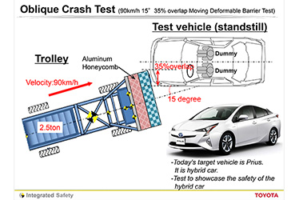
Appendix- Detailed Tangible Costs Breakdown
Increased Material Testing:
Definition: Additional testing to ensure materials meet industry or regulatory standards.
Breakdown:
30 tests (QTY) include stress tests, chemical analysis, durability checks, or safety validations.
$5,000 per test covers:
Lab fees (third-party or in-house).
Sample preparation and destruction.
Compliance documentation.
Total Cost: 30QTY × $5,000 = $150,000

Slide 35

Appendix- Detailed Tangible Costs Breakdown
Manpower Fees for Upgrading
Definition: Costs for hiring specialists to modify software, hardware, or processes.
Breakdown:
10 engineers/programmers (QTY) for tasks like:
Software updates for compliance (e.g., cybersecurity, data handling).
Hardware redesign for improved safety/reliability.
$15,000 per unit reflects:
Salaries for skilled professionals (e.g., testing engineers, AI ethics specialists).
Contracted consultants for ISO implementation.
Total Cost: 10QTY × $15,000 = $150,000

Slide 36
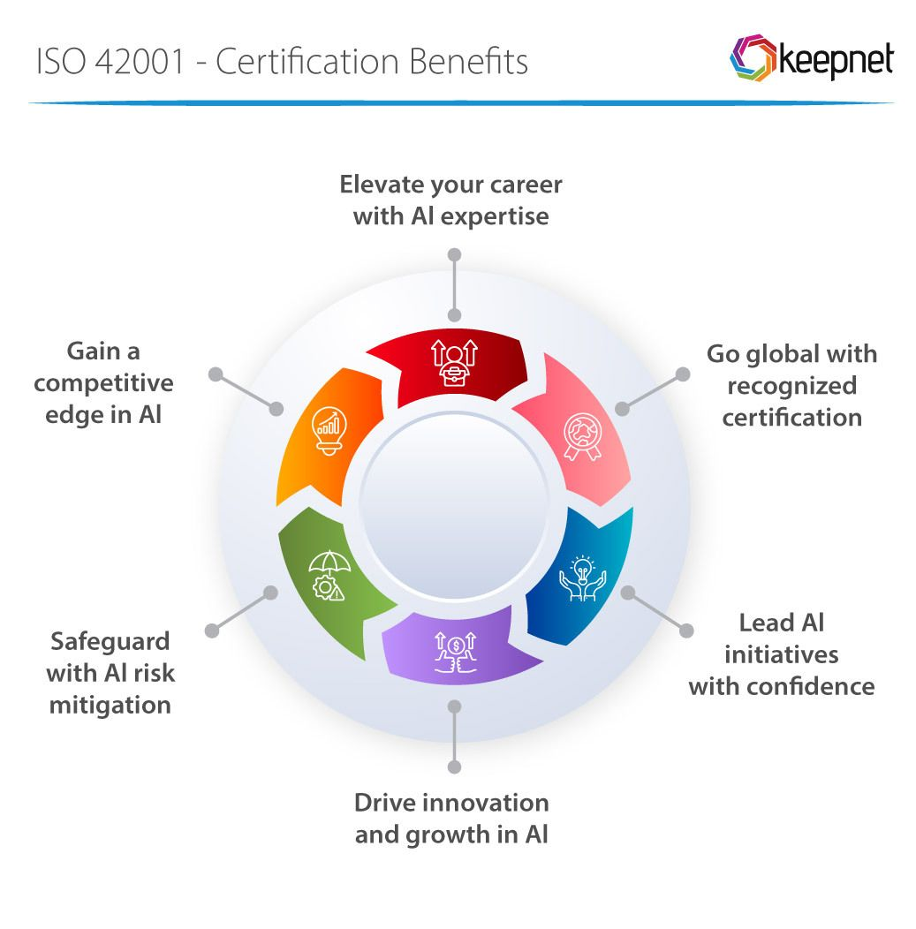
Appendix- Detailed Tangible Costs Breakdown
Initial Certification Costs
Definition: Fees for obtaining mandatory or voluntary certifications.
Breakdown:
Initial certifications/licenses (QTY), such as:
ISO 42001 (AI governance ~$20,000–$50,000 depending on org size).
$50,000 per unit includes:
Application and audit fees.
Consultant fees for documentation prep.
Surveillance audits (annual renewals).
Total Cost: 1QTY × $50,000 = $50,000

Slide 37


Appendix- Detailed Tangible Costs Breakdown
Production Delay Cost
Definition: Financial impact of missing deadlines due to certification delays, supply issues, or redesigns.
Breakdown:
1 delay event (QTY) caused by:
Rework after failed material tests.
$150,000 cost covers:
Penalties for late delivery.
Idle production line costs.
Expedited shipping to compensate.
Total Cost: 1QTY × $150,000 = $150,000

Slide 38
Appendix-Table Tangible Costs Breakdown (Short-term)
Fees | QTY | Price Per Unit | Total Budget
Increased Material Testing | 30 | $5000 | $150,000
Manpower Fees for Upgrading (Testing Engineers/App Programmer) | 10 | $15,000 | $150,000
Initial Certification Costs | 1 | $50,000 | $50,000
Production Delay Cost | 1 | $150,000 | $150,000
 |  | Subtotal | HK$ 500,000

Slide 39
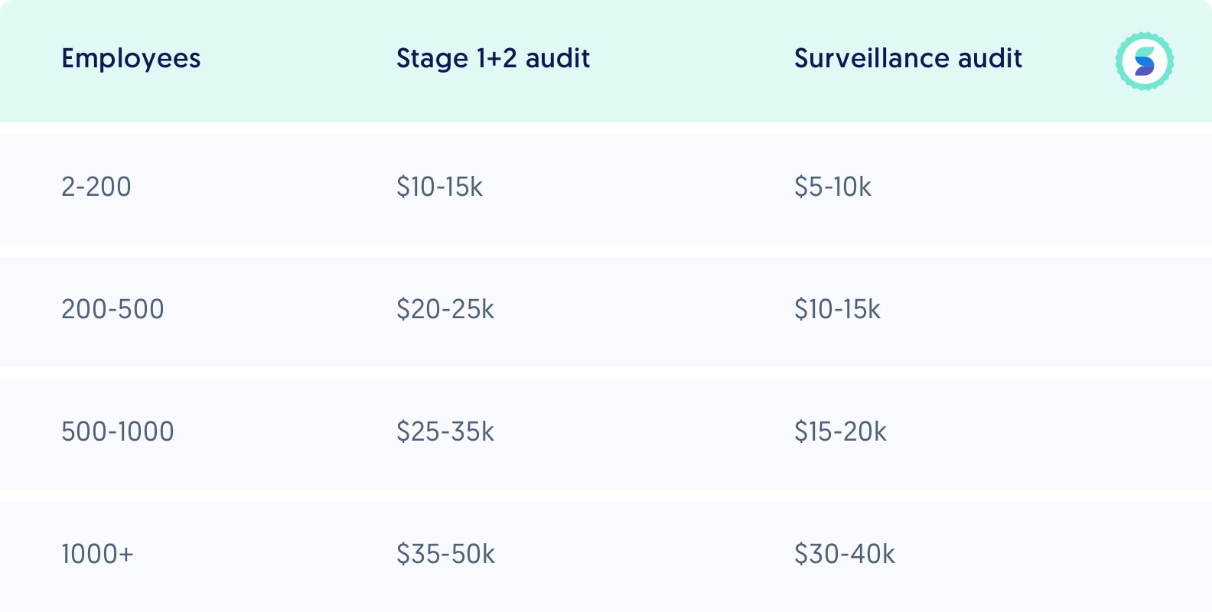
Appendix- Detailed Tangible Costs Medium/Long-Term
Medium/Long Term Certification Costs
Definition: Fees for obtaining mandatory or voluntary certifications.
Planning to earn certifications/licenses:
ISO 9001: HKD 50,000 - 150,000
ISO 37002: HKD 30,000 - 100,000
ISO 37001: HKD 80,000 - 200,000
ISO 19011: HKD 20,000 - 50,000
ISO 37000: HKD 50,000 - 150,000
IATF 16949: HKD 100,000 - 300,000
ISO 42001: HKD 50,000 - 150,000
ISO 23894: HKD 40,000 - 120,000
ISO 27001: HKD 80,000 - 250,000
ISO 5338: HKD 50,000 - 150,000
Total Estimated Cost: HKD 450,000 - 1,520,000
Example cost of ISO 27001

Slide 40
Appendix-Tangible Benefits Breakdown
Benefits | QTY | Price Per Unit | Total Budget
Increased Revenue from Market Share | 20 | $50,000 | $1,000,000
Reduced Liability Costs | 10 | $20,000 | $200,000
Avoidance of Recall Costs | 30 | $10,000 | $300,000
Operational Cost Savings | 20 | $20,000 | $400,000
Tax Incentives and Grants | 1 | $100,000 | $100,000
 |  | Subtotal | HK$ 2,000,000

Slide 41
Reference
[1] Daihatsu Motor Co., Ltd. (2023). Daihatsu Global Production Report 2023. [Report]. Osaka: Daihatsu Motor Co., Ltd.
[2]Toyota Motor Corporation. (2023). Toyota ASEAN Strategy Report 2023. [Report]. Tokyo: Toyota Motor Corporation.
[3] Japan Automobile Manufacturers Association [JAMA]. (2023). Automotive Industry Outlook in Japan 2023. [Report]. Tokyo: Japan Automobile Manufacturers Association.
[4] Asahi Shimbun. (2023, December). We were pressured to skip retests to meet launch deadlines. Management prioritized speed over safety [Interview with Daihatsu engineer]. Retrieved from https://www.asahi.com
[5] NHK Investigation. (2023, December). Weak whistleblower systems allow quality issues to escalate unnoticed [Internal audit report]. Retrieved from https://www.nhk.or.jp
[6] A. Ahmad, M. Saad, J. Kim, D. Nyang and D. Mohaisen, “Performance Evaluation of Consensus Protocols in Blockchain-based Audit Systems," 2021 International Conference on Information Networking (ICOIN), Jeju Island, Korea (South), 2021, pp. 654-656, doi: 10.1109/ICOIN50884.2021.9333867.

